Slide 1
CAPTAIN OF MY SHIP
Encounter Service
27 Feb 2016
Cecil Ang

Slide 2
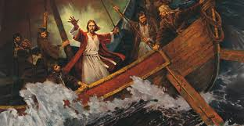
“He calms the storm, so that its waves are still. Then they are glad because they are quiet; so He guides them to their desired haven.” Ps 107:29-30 NKJV

Slide 3
Mark 4:35-41 NKJV
³⁵ On the same day, when evening had come, He said to them, “Let us cross over to the other side.” ³⁶ Now when they had left the multitude, they took Him along in the boat as He was. And other little boats were also with Him. ³⁷ And a great windstorm arose, and the waves beat into the boat, so that it was already filling. ³⁸ But He was in the stern, asleep on a pillow. And they awoke Him and said to Him, “Teacher, do You not care that we are perishing?”

Slide 4
Mark 4:35-41 NKJV
³⁹ Then He arose and rebuked the wind, and said to the sea, “Peace, be still!” And the wind ceased and there was a great calm. ⁴⁰ But He said to them, “Why are you so fearful? How is it that you have no faith?” ⁴¹ And they feared exceedingly, and said to one another, “Who can this be, that even the wind and the sea obey Him!”

Slide 5
1. Jesus wants us to remember His Promises
Salvation and eternal life
“Most assuredly, I say to you, he who hears My word and believes in Him who sent Me has everlasting life, and shall not come into judgment, but has passed from death into life.” Jn 5:24 NKJV
Appropriating God’s promises as found in His Word
“For all the promises of God in Him are Yes, and in Him Amen, to the glory of God through us.” 1 Cor 1:20 NKJV

Slide 6
1. Jesus wants us to remember His Promises
Accomplishing the work God has for our lives
“And David said to his son Solomon, “Be strong and of good courage, and do it; do not fear nor be dismayed, for the Lord God—my God—will be with you. He will not leave you nor forsake you, until you have finished all the work for the service of the house of the Lord.”
1 Chron 28:20 NKJV

Slide 7
1. Jesus wants us to remember His Promises
When a person makes a promise, he stretches himself out into circumstances that no one can control and controls at least one thing: he will be there no matter what the circumstances turn out to be. With one simple word of promise, a person creates an island of certainty in a sea of uncertainty. When a person makes a promise, she stakes a claim on her personal freedom and power. When you make a promise, you take a hand in creating your own future.
Lewis Smedes, "The Power of Promises"

Slide 8
1. Jesus wants us to remember His Promises
Many a man proclaims his own steadfast love, but a faithful man who can find? Pr 20:6 ESV
“… if we are faithless, he remains faithful— for he cannot deny himself.” 2 Tim 2:13 ESV

Slide 9
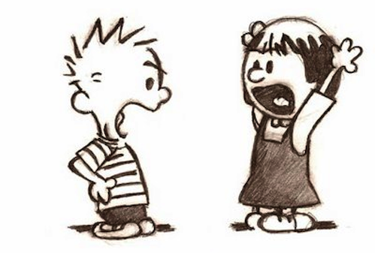
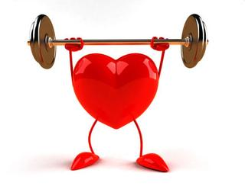

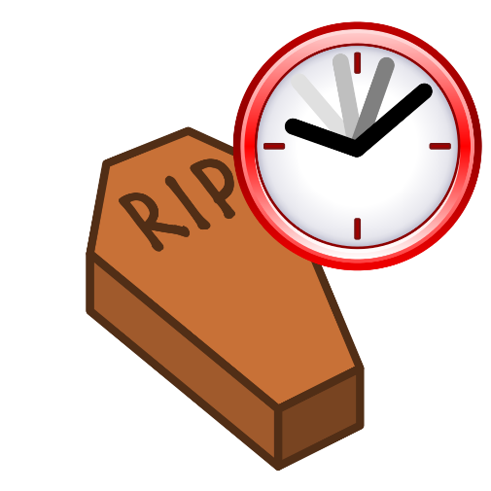
2. Jesus wants us to rest in His Presence
Relationships
                Health
Finance
              Death

Slide 10
2. Jesus wants us to rest in His Presence
“Behold, the virgin shall be with child, and bear a Son, and they shall call His name Immanuel,” which is translated, ‘God with us’. Matt 1:23 NKJV
“ … and lo, I am with you always, even to the end of the age.” Amen. Matt 28:20 NKJV
For we do not have a High Priest who cannot sympathize with our weaknesses, but was in all points tempted as we are, yet without sin. Heb 4:15 NKJV

Slide 11
3. Jesus wants us to rely on His Power
Fear focuses on the storm/problem
Faith focuses on the Saviour/God.
“ … for assuredly, I say to you, if you have faith as a mustard seed, you will say to this mountain, ‘Move from here to there,’ and it will move; and nothing will be impossible for you.” Matt 17:20 NKJV
“if one member suffers, all the members suffer with it; if one member is honoured, all the members rejoice with it” 1 Cor 12:26 NKJV

Slide 12
3. Jesus wants us to rely on His Power
“If the world hates you, know that it has hated me before it hated you. If you were of the world, the world would love you as its own; but because you are not of the world, but I chose you out of the world, therefore the world hates you. Remember the word that I said to you: ‘A servant is not greater than his master.’ If they persecuted me, they will also persecute you.” Jn 15:18-20 NKJV

